Slide 1
Apps in Myanmar

Slide 2
Supervisor Daw Ank Phyu Win
Submitted By
5CS-25 Ma Khin Su Myat Noe
5CS-26 Ma Su Po Po
5CS-27 Mg Han Htun Aung
5CS-28 Mg Kaung Myat Thu
5CS-29 Ma Hla Yamin Htike
5CS-30 Ma Hnin Yu Aung

Slide 3
Acknowledgement
First, We would like to thankful greatly following persons who have contributed directly or indirectly towards the success of this project.
We would like to respectfully thank U Kyaw Swar Soe, Rector of Computer University (Mandalay), Dr. San San Tin,Pro Rector of Computer University(Mandalay), Dr. Aye Aye Chaw , and Dr. Mya Thida Kyaw, for his kind permission to carry out this project, general guidance and workable environment during the period of study.
We would like to express our Director, U Ravi Chhabra(COO,Geo Mandalar Investment and Technology/CTO, NovaSteps Technologies), Director of our Geo-Delta-MDY group, for his guide way to create our project with successfully and nicely.
We also wish to express our supervisor, Daw Ank Phyu Win, Lecturer of faculty of Computing , Computer University (Mandalay), for her helpful advice, helpful encouragement numerous invaluable suggestion and comments. We also great full to all out teachers for Computer University ( Mandalay ) who have taught and guided us during the period of study.
Finally, we are thankful to our follow members who work together in this project and we also thanks again for the unity.

Slide 4
Abstract
Apps In Myanmar(AIM) describes a search interface to Application information and investigates the search result presentation on information finding. By using this system, users can easily search the Applications in Myanmar with detail information. This system can reduce time wasting. Users can also know the latest Apps and Top Apps.
Moreover, user can download the application as the AIM links with the Google Play Store. So, with the help of this system, user can get about applications in Myanmar in one place.

Slide 5
Declaration
The information contained in this applications in Myanmar are true, correct and complete.
Most of the applications are shown in this system, not all of application in Myanmar.
We understand that any misrepresentation may invalidate my application arrangements.
We noted that all appointments are project details.
Project Details
Project Title | Apps in Myanmar
Project ID | Geo Mandalar Company Internship

Slide 6
Objectives
To avoid time consuming problem
To improve search performance
To offer useful information for user
To use available anytime, anywhere
To be easy to download the application that the user would like to use in one place

Slide 7
Introduction of Apps in Myanmar
Apps in Myanmar will involve various applications in Myanmar
Users can download the applications and also see details that related applications
Moreover, users can also see publisher’s details who were written these applications

Slide 8
Description
Apps in Myanmar (AIM) is a web application. Apps in Myanmar. (AIM) is the useful application for the users who would like to know the Myanmar Apps and download them to use. AIM provides the information for application developed in Myanmar. It describes all kinds of application details- Updated date, Size, Installs, Current Version, Requires Android, Offered By and Developer. This system also links with Google Play-store. So, if you want to download the app you want, you can download the app with the help of AIM. That is why it also performs the third party web site. It has the various user feedback notifications to the admin and can update user's requirement on this system. It can provide user for more accurate information and more effective valuation of the time consuming and cost. It must keep the up-to-date records of all the applications in Myanmar. It can reduce storage size in traditional way. This system is implemented by using HTML, CSS, Java script, and Firebase.

Slide 9
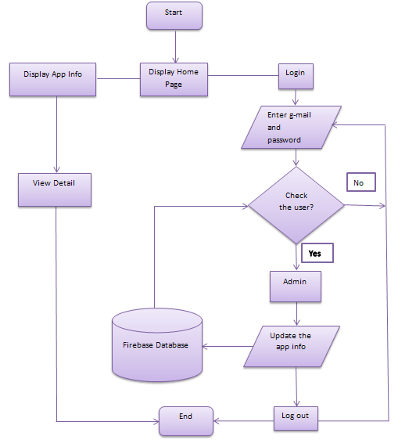
Flow Chart For Apps In Myanmar

Slide 10
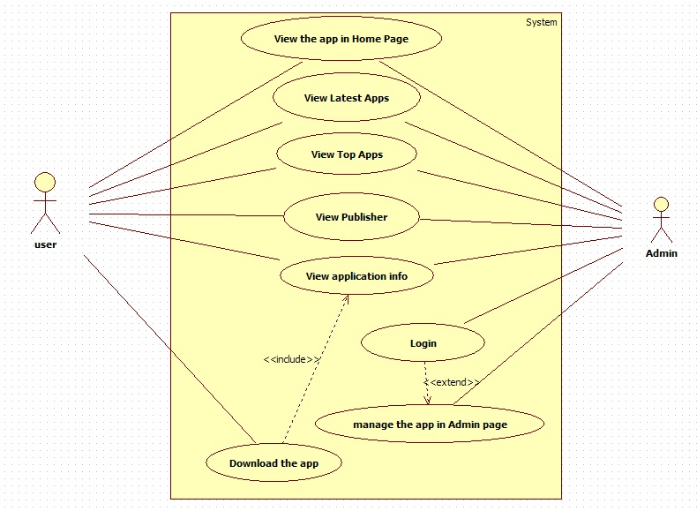
Use case Diagram

Slide 11
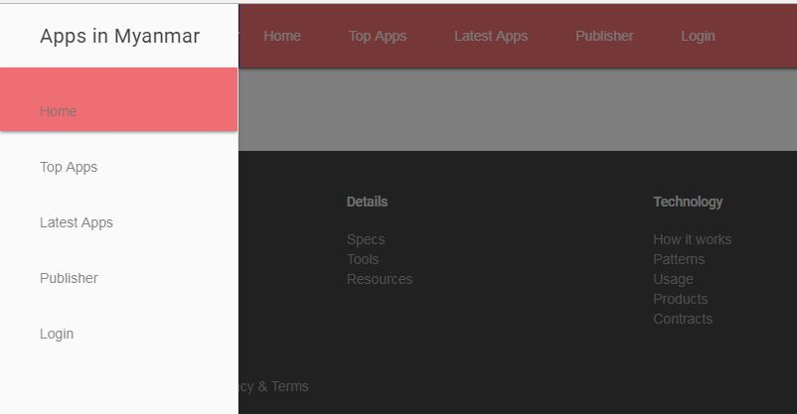
Implementation for Apps in Myanmar Home Page Screen

Slide 12
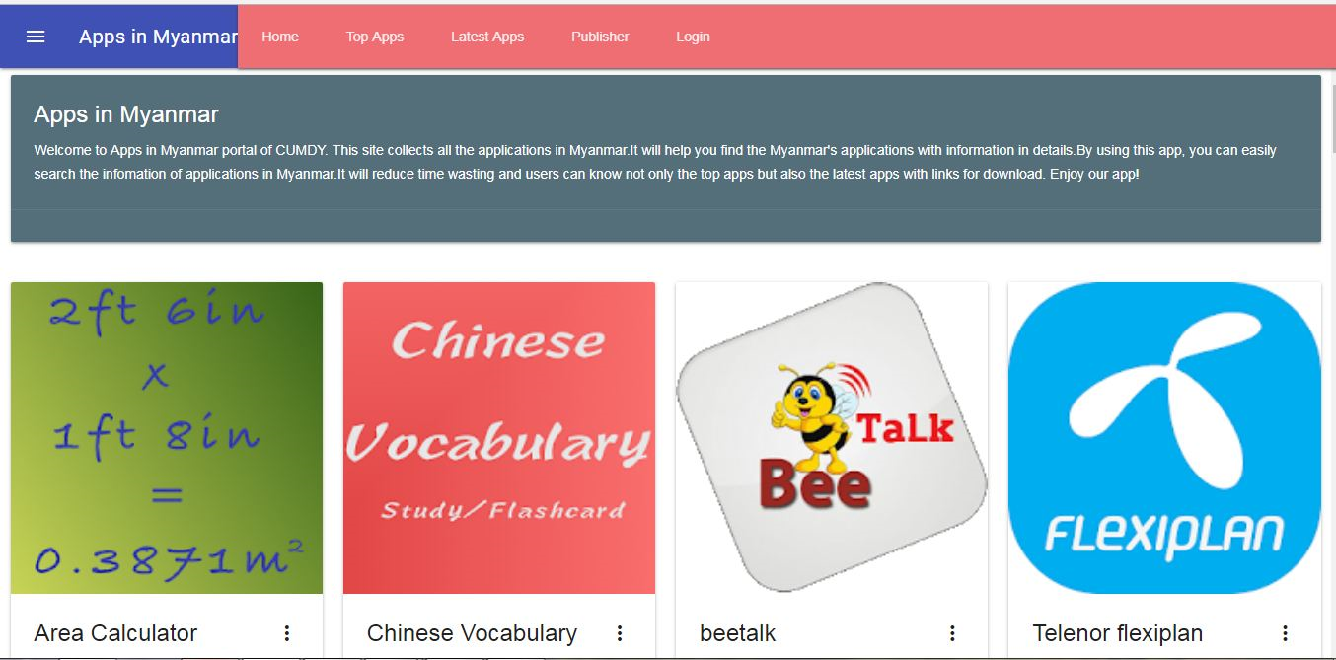
Home Page for Apps in Myanmar

Slide 13
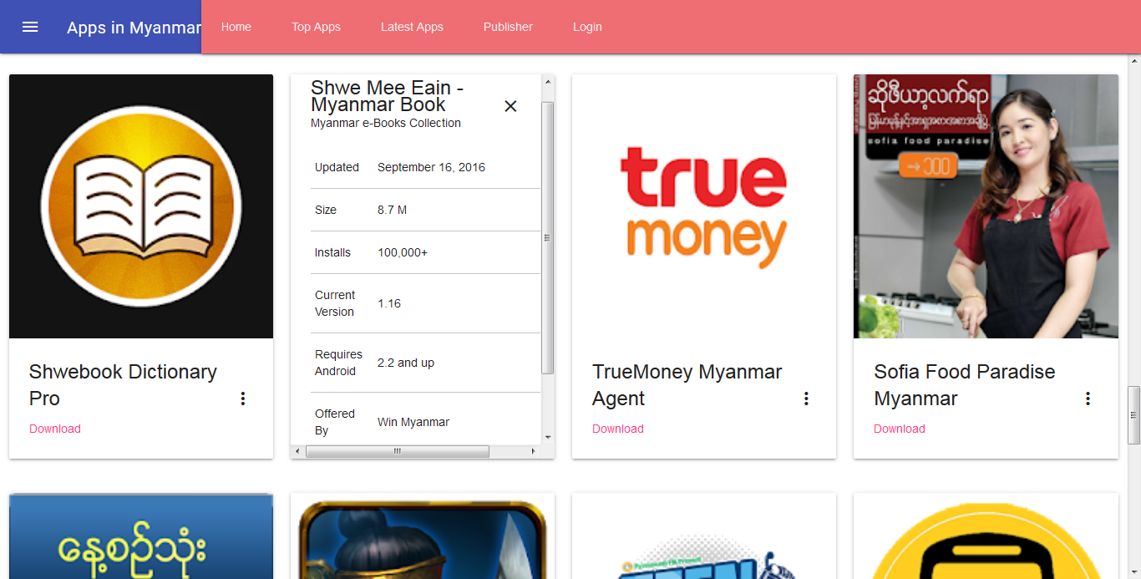
App Item in Home Page of Apps In Myanmar

Slide 14
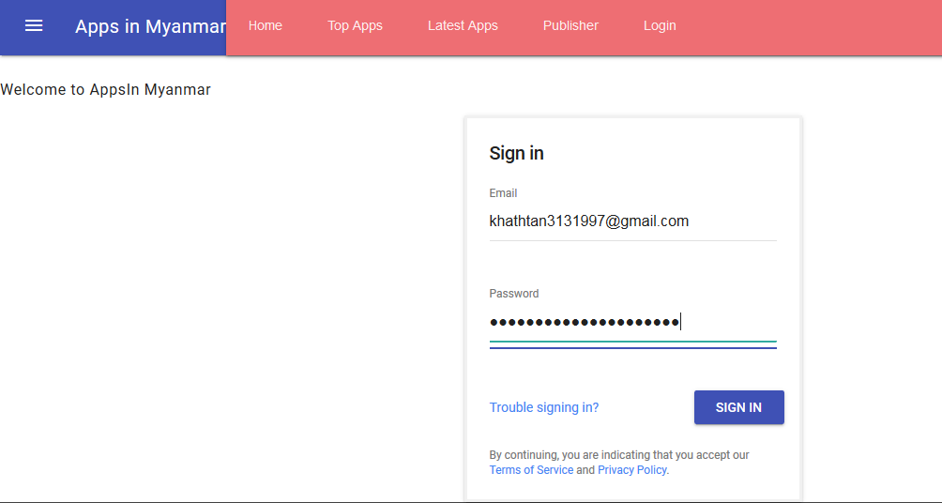
Login and Sign in for Apps in Myanmar

Slide 15
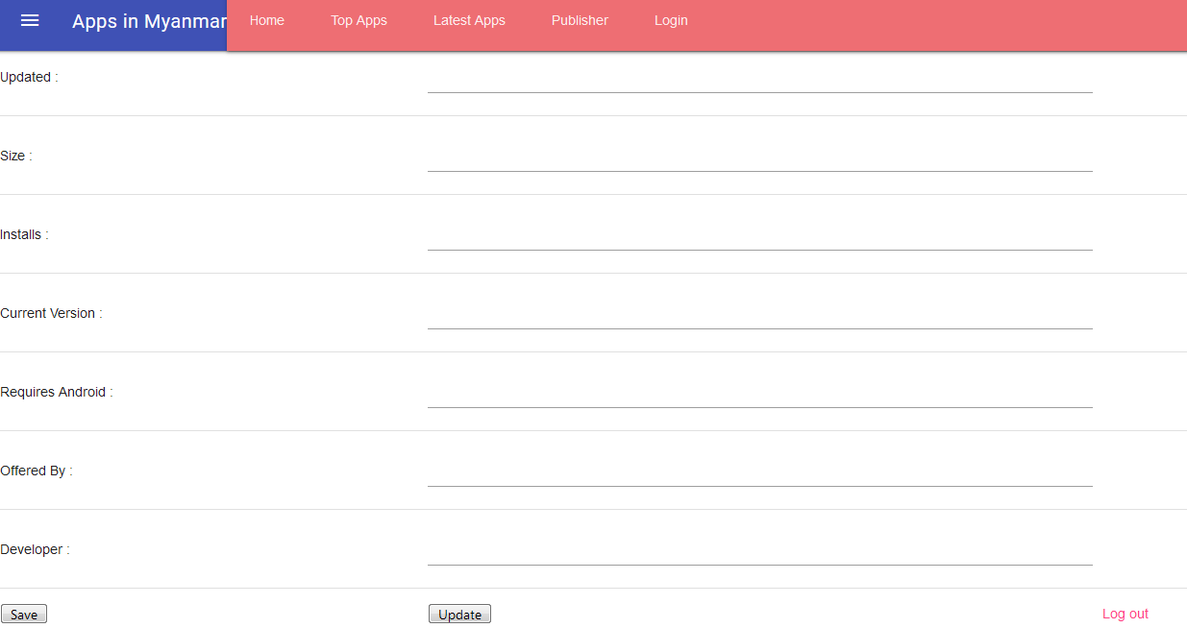
Admin Page of Apps in Myanmar

Slide 16
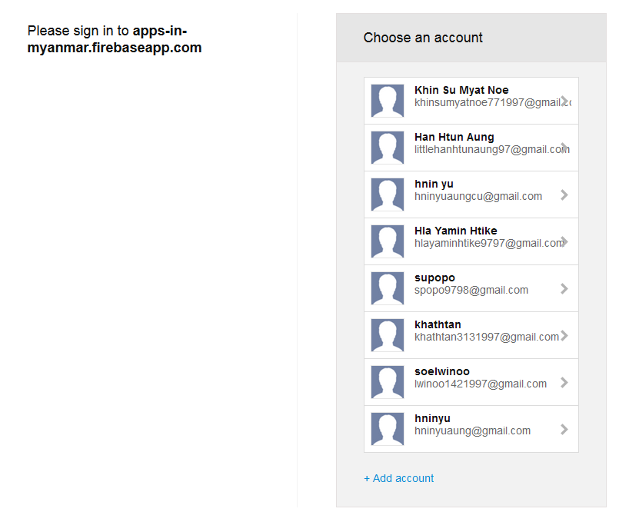
After logout the Admin Page

Slide 17
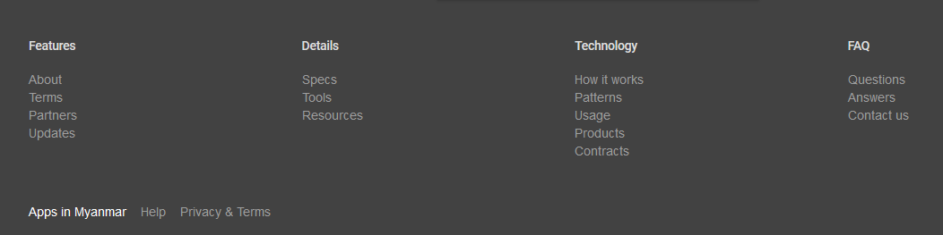
Footer of Apps in Myanmar

Slide 18
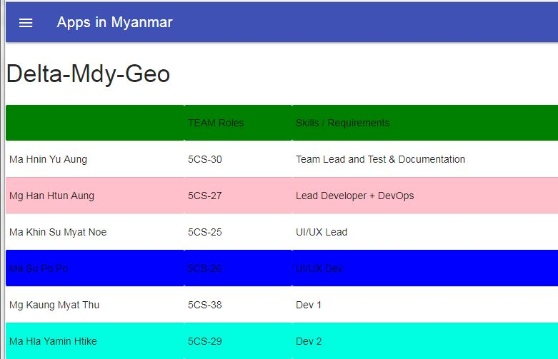
About page of Apps in Myanmar

Slide 19
Conclusion
Application in Myanmar(AIM) assists in searching the application developed in Myanmar. AIM is a web application hosted by Firebase. It can be monitored and controlled remotely. It provides accurate information always. This application gathered details information of apps and can be accessed at any time. So it is better to have a Web Based Information system.
The authentication of this system is protected by login form. Therefore, only authorized persons (Admin or Hostel owners) can manage the application information. Normal users can only see the information.
All the user can get the required information without delay. This system is essential in searching application developed by Myanmar . AIM supports for user-friendly and up-to-date application information. Moreover, with the help of this web based app, not only user can get the applications info in details but also the application can easily be downloaded via download link.

Slide 20
THANKS ALL

